Slide 1


Reducing Road Deaths among Young People
Czech PIN Talk, Prague | 20 October 2022
Jenny Carson
Project Manager

Slide 2
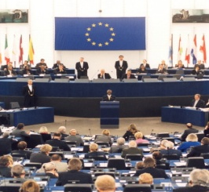





Road Safety Performance Index (PIN)
Ranking EU countries‘ performances
Monitoring EU transport
safety policy
SAFE & SOBER
DRUG DRIVING

Slide 3
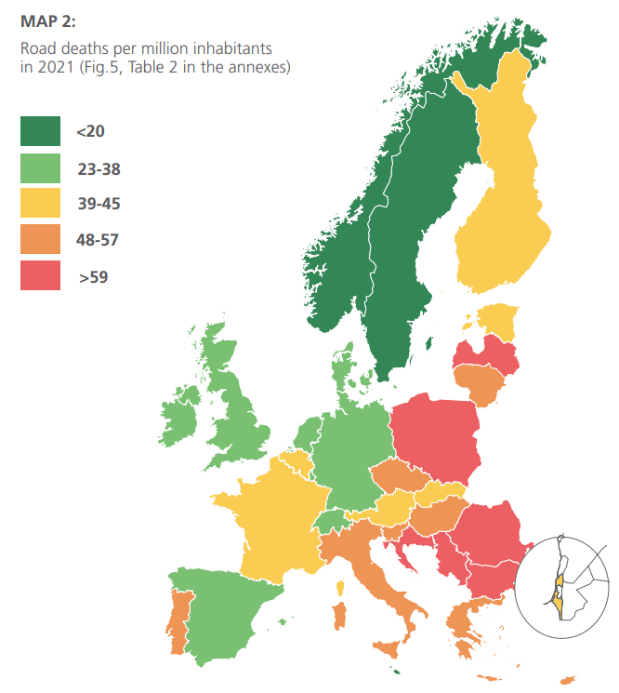





ETSC PIN PROGRAMME
Ranking road safety performance across participating countries since 2006
Experts from the 32 participating countries, including all EU Member States
Steering group
Project team in the ETSC secretariat
43 PIN Flash reports

Slide 4
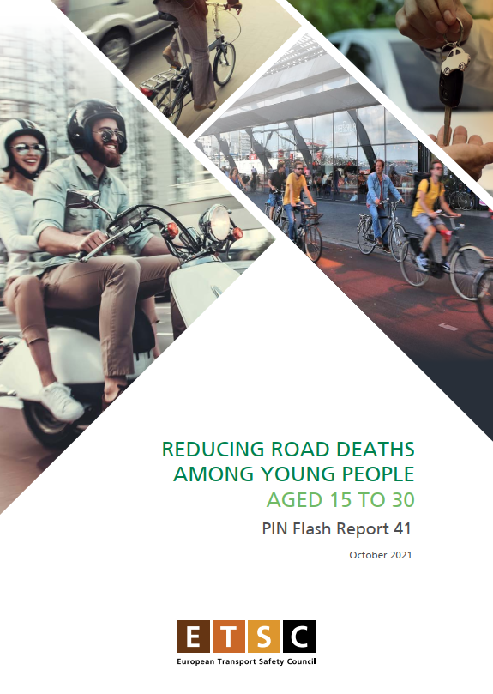
PIN Flash Report 41
Reducing Road Deaths among Young People aged 15-30
Published October 2021

Slide 5
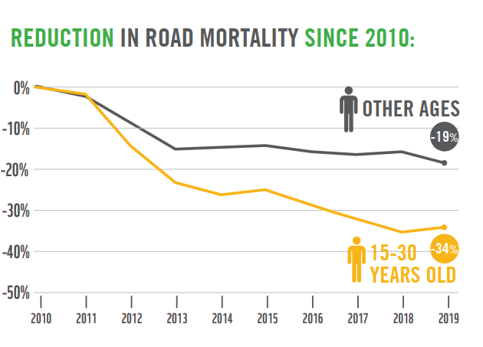

The Scale of the Problem

Slide 6
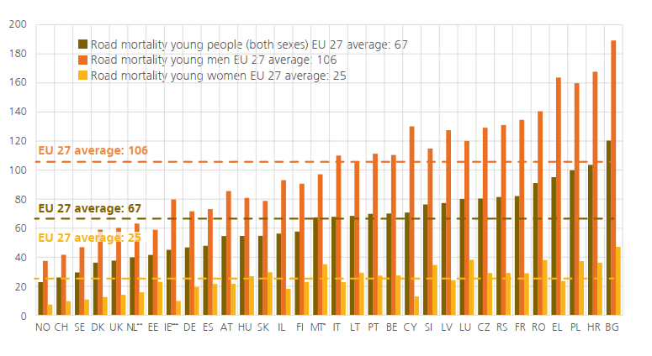
The gender issue

Slide 7
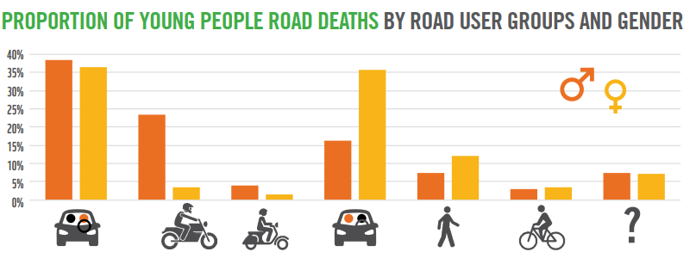
Road user groups and gender

Slide 8

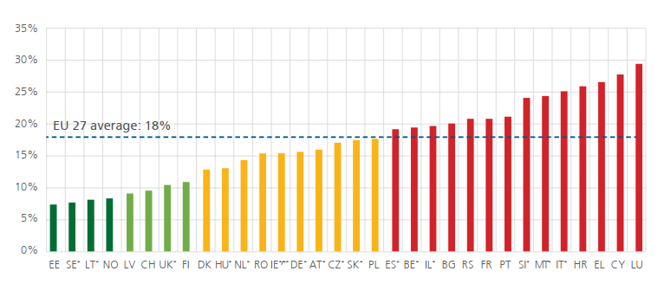
Road deaths as a proportion of all deaths

Slide 9
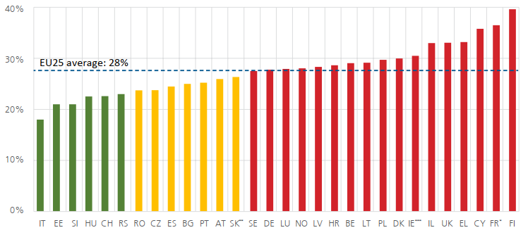
Serious Injuries
Serious injuries among young people as a proportion of all serious injuries (national definition)

Slide 10

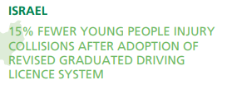

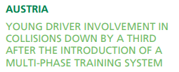

ETSC PIN PROGRAMME

Slide 11
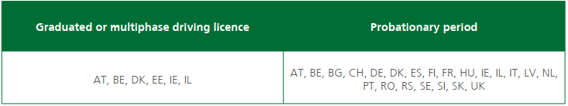
Countermeasures
Driver training
Minimum age for obtaining a driving licence
Graduated driving licences
Alcohol, drugs and distraction
Protective equipment – seatbelts and helmets
Safer vehicles

Slide 12
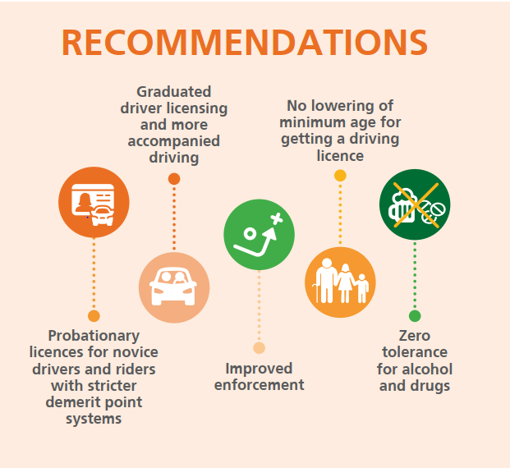

Slide 13
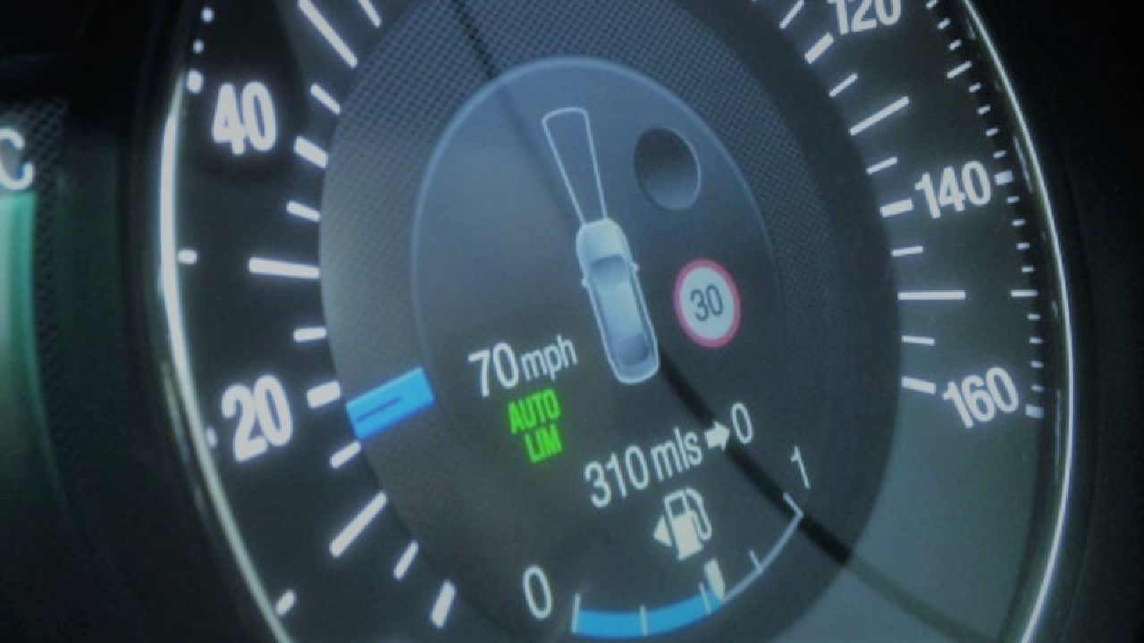

THANK YOU!
www.etsc.eu/pin
@etsc_eu
Jenny Carson
jenny.carson@etsc.eu

