Slide 1
Reducing Road Deaths among Young Drivers in Germany
PIN – event Prague
20th October 2020,
Chamber of Deputies, Parliament of the Czech Republic
Jacqueline Lacroix German Road Safety Council

Slide 2
Agenda
Novice drivers in the probationary
period: more safety through an
extended learning period
Zero alcohol tolerance law for novice drivers

Slide 3
YOUNG PEOPLES RISK in TRAFFIC 2020
Young people between 18 and 24 years still have the highest risk of being involved in a road traffic accident in Germany.
7,5 %
of total population
12 %
of fatalities (326 killed persons) -
like three crashes of an Airbus 319
15,5 %
of injured (50.210 persons)
Source: Federal Statistic Office, Traffic Accident Statistics

Slide 4
YOUNG and NOVICE DRIVERS
Lack of driving experience
Lack of drinking experience
SPEED
OVERTAKING MANOEUVRES
OVERESTIMATION
PEER PRESSURE
DISTRACTION

Slide 5
BF 17 – A MODEL OF SUCCESS

Slide 6
EXTENSION OF THE LEARNING PROCESS including BF 17
Education / theoretical and practical examination
2 years probationary period
BF17
16,5 years
17 years
Pilot startet in April 2004
Nationwide introduction Januar 2011

Slide 7
EVALUATION
19% less accident involvement in the first year of driving a car alone
18% less traffic violations in the first year of driving a car alone
Source: Schade & Heinzmann 2011, BAST-Report M 218

Slide 8
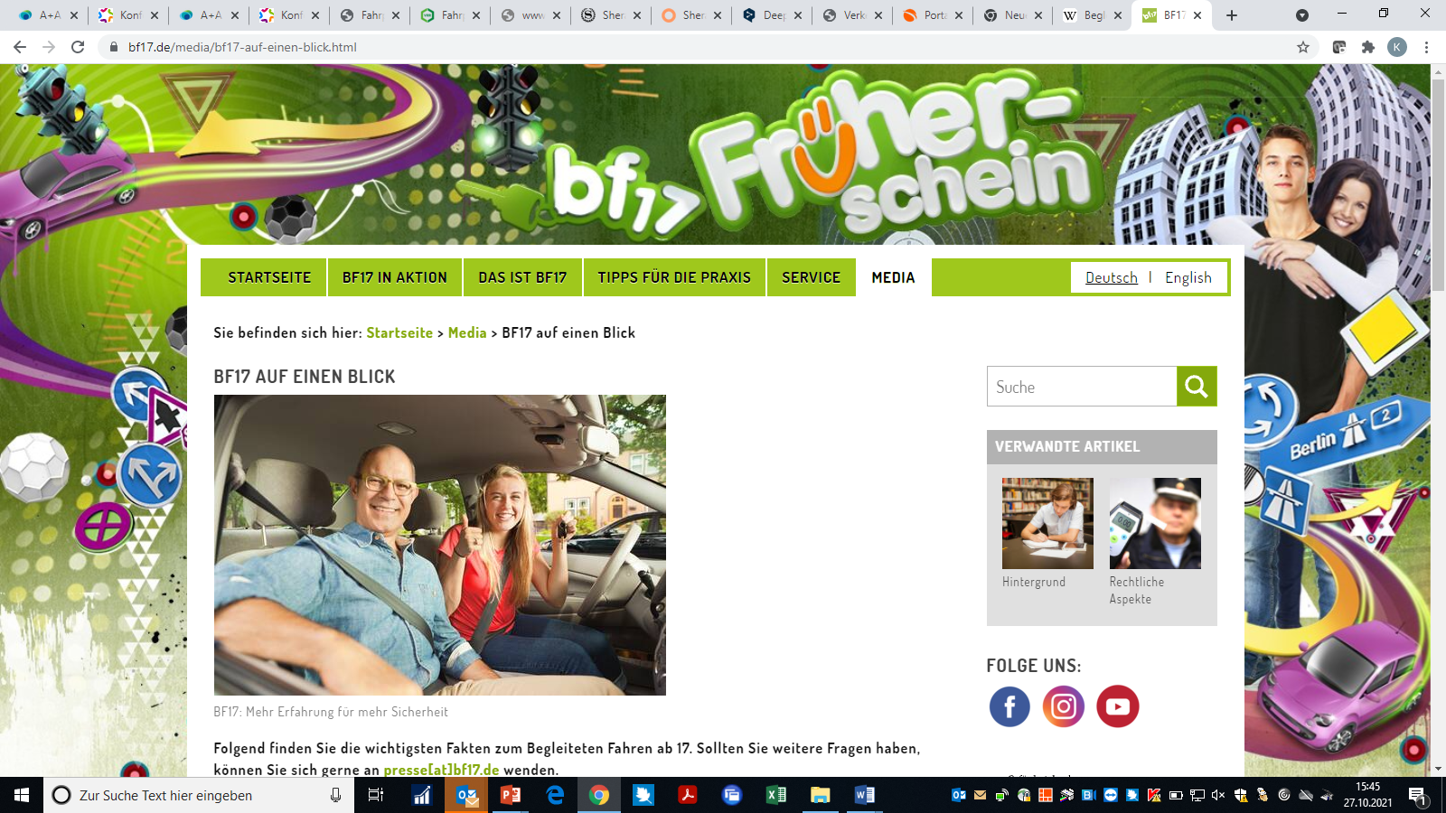
INFORMATION ABOUT BF17
www.bf17.de
– Facebook
– Instagram

Slide 9
CONCLUSIONS
BF 1 has shown to be successful and to contribute to the reduction of accidents and casualties among young novice drivers
DVR wishes to extend the BF17 scheme to BF 16
DVR asks for BF 17 also for class C and C1

Slide 10
INTRODUCTION AND FIRST EVALUATION OF THE ZERO ALCOHOL LAW
FOR NOVICE DRIVERS
Introduction of the zero tolerance law for novice drivers on 1st August 2007
- for novice drivers in the probationary period (2 years)
- for novice drivers below 21 years of age
Results of the 1st evaluation done in 2010 by the Federal Highway Research Institute BASt
- Reduction of alcohol-related accidents by -15%
- Reduction of alcohol-related offences by - 17%
- High acceptance among the target group

Slide 11
RE-EVALUATION in 2018
Maintenance of the methodology of the 1st evaluation.
Investigation of the long-term effect and assessment whether the law had a socialising effect regarding young vehicle drivers towards drink-driving.
- Analysis of accident data
- Analysis of DUI-alcohol offences
- Survey related to acceptance and behavioural intentions

Slide 12
RESULTS (1)
Significant reduction of the proportion of novice drivers involved in accidents
before: 11,7%
after: 8,7%
Reduction of drivers involved in accidents among 21+ years old drivers who passed the probationary period under the influence of alcohol
Average 18-20 years
Average 21+ years after the probationary period
Proportion of car drivers under alcohol-influence compared to all car drivers
who caused accidents per quater year periods 2005-2018

Slide 13
RESULTS (2)
< 21 years ≥ 21 years
Alcohol-related administrative traffic offence
2016 vs. 2007/08
-71,4% -39,6 %
Alcohol-related criminal traffic-offence
2016 vs. 2007/08
-62,5 % -19,9 %
- Since the data in the offence register does not show information about the probationary period, the data was analysed based on age (below and over 21 years)
- The access of offences in the database before and after the introduction of the alcohol ban law for novice drivers was compared with the data of the access of offences in 2016
- Data of 2016: 50% sample, therefore an extrapolation was needed

Slide 14
RESULTS (3)
The acceptance of the alcohol ban of novice drivers of 2018 was compared with novice drivers of 2008. Those novice drivers who belong to the first cohort (group) of drivers which had to comply with the alcohol ban were asked again in 2018 to analyse a long-term effect.
ND 2008 | ND 2018 | 1st cohort
95,8 % | 97,2 % | 98,3 % | Meaningful safety measure
43,7 % | 50,6 % | 50,3 % | Impairement is higher for ND
12,1 % | 8,0 % | --- | unjust treatment for ND
--- | 10,6 % | --- | Restriction for the mobility
ND 2008 | ND 2018 | 1st cohort
5 % | 11,4 % | 10,9 % | I don´t drink alcohol
44,8 % | 28,8 % | 35,5 % | I drive every day
50,7 % | 12,7 % | 6,3 % | I waive drinking alcohol to be able to drive

Slide 15
CONCLUSIONS
The first evaluation was confirmed
Acceptance increased
Long-term reduction of alcohol-related accidents and offences among novice drivers underline the effectiveness of the ban
Lasting effect after the alcohol ban period

Slide 16
THANK YOU!
QUESTIONS?
Jacqueline Lacroix
jlacroix@dvr.de

